Slide 1
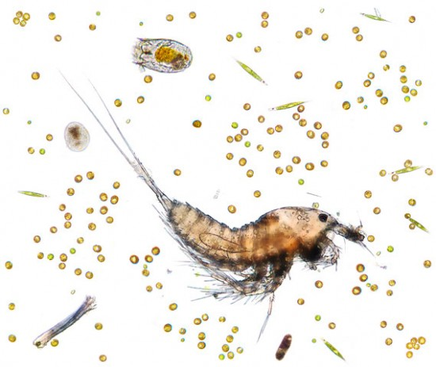
Photo by: http://gakuranman.com/anglerfish-ovary-microscopic-photography/

Slide 2
A eukaryote(cell with a nucleus) that is not a plant animal or fungus
Most protists are unicellular/single celled organism and live in water

Slide 3
Animal-Like Protists
Usually motile(moves around)
Heterotrophic – must consume food
Examples: amoeba, paramecium
Classified by how they move

Slide 4
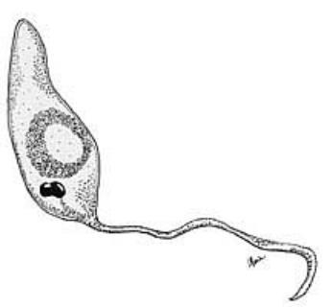
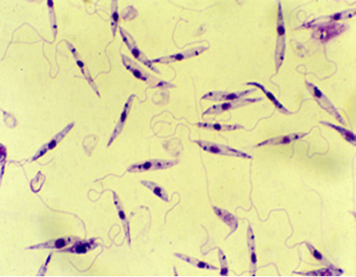
Move using a flagella (hair like structure)

Slide 5
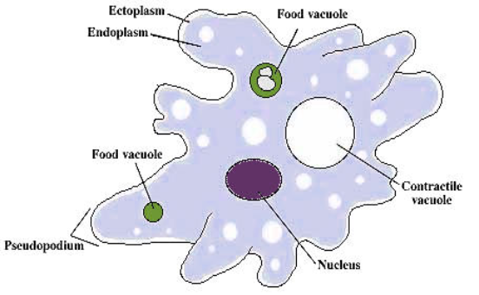
Move using cytoplasmic extensions called pseudopodia (“false feet”)
Movement is also called ameboid movement

Slide 6
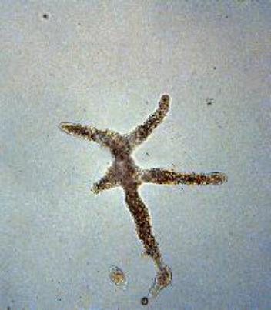
Amoeba - Phylum Sarcodina

Slide 7
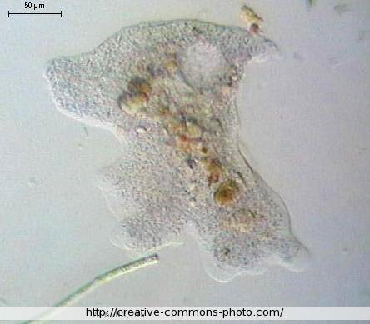
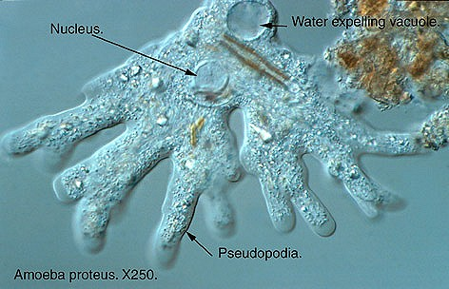
The word “amoeba” means “to change”.
Their cytoplasm is always moving, they never look the same.

Slide 8
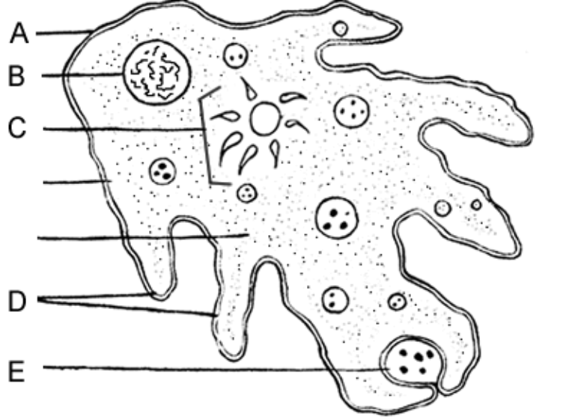
See: Ameba Coloring

Slide 9
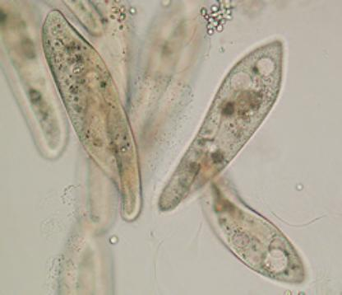
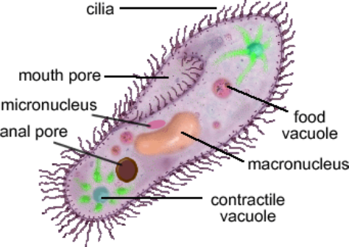
Protists that move using cilia
Ex: Paramecium

Slide 11
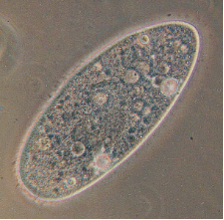
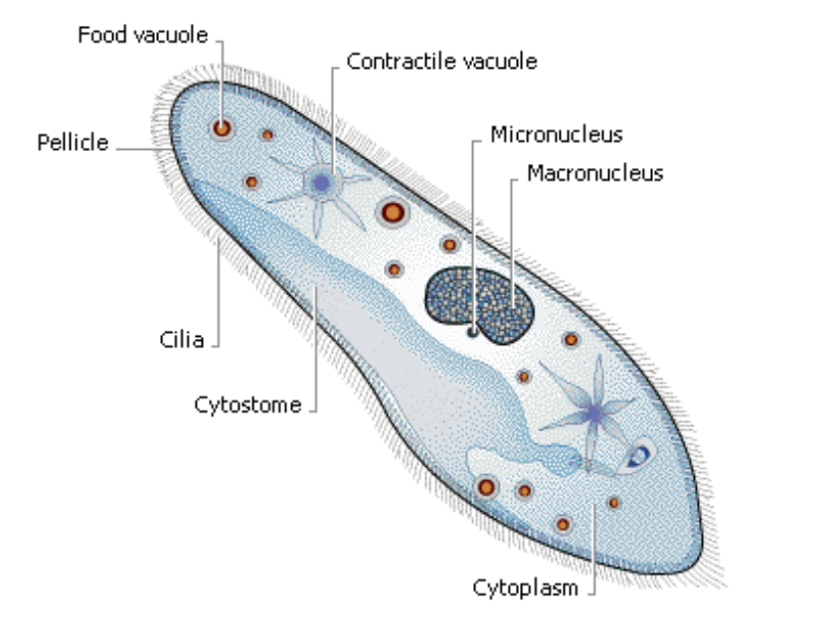

Slide 12
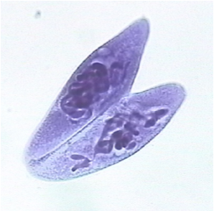
Paramecium join and exchange DNA
Then, they divide (mitosis) and the offspring are different from the original parent
This is a form of SEXUAL reproduction

Slide 13
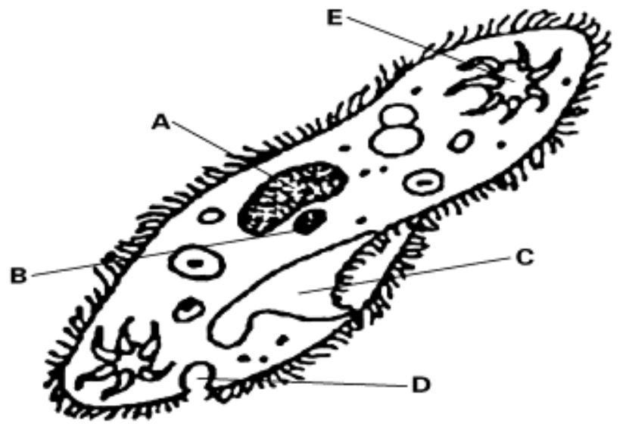
1. Mouth Pore
2. Contractile Vacuole
3. Micronucleus
4. Macronucleus
5. Anal Pore

Slide 14
1. ____ Kingdom that an ameba belongs to
2. ____ Extensions of cytoplasm
3. ____ How a paramecium moves
4. ____ Sexual reproduction in paramecium
5. ____ Removes excess water
6. ____ A protist that changes shape
Contractile vacuole
Pseudopodia
Conjugation
Amoeba
Cilia
Protista

Slide 15
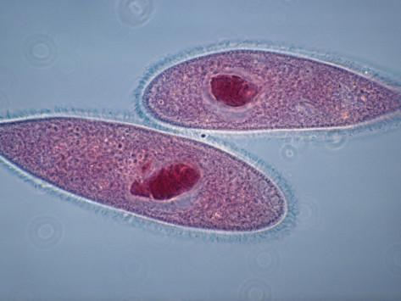
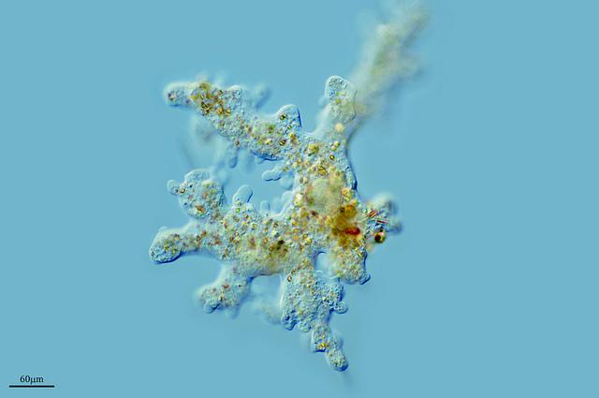
What are the common names for these protists?

Slide 16
The Ameba That Ate Brains!
1. How does a person get a brain-eating amoeba?
2. What does “mortality rate” mean?
3. How can you prevent getting a brain eating amoeba?

